Slide 1
Publishing A Mini Program
Training For Ant Financial Mini Program

Slide 2
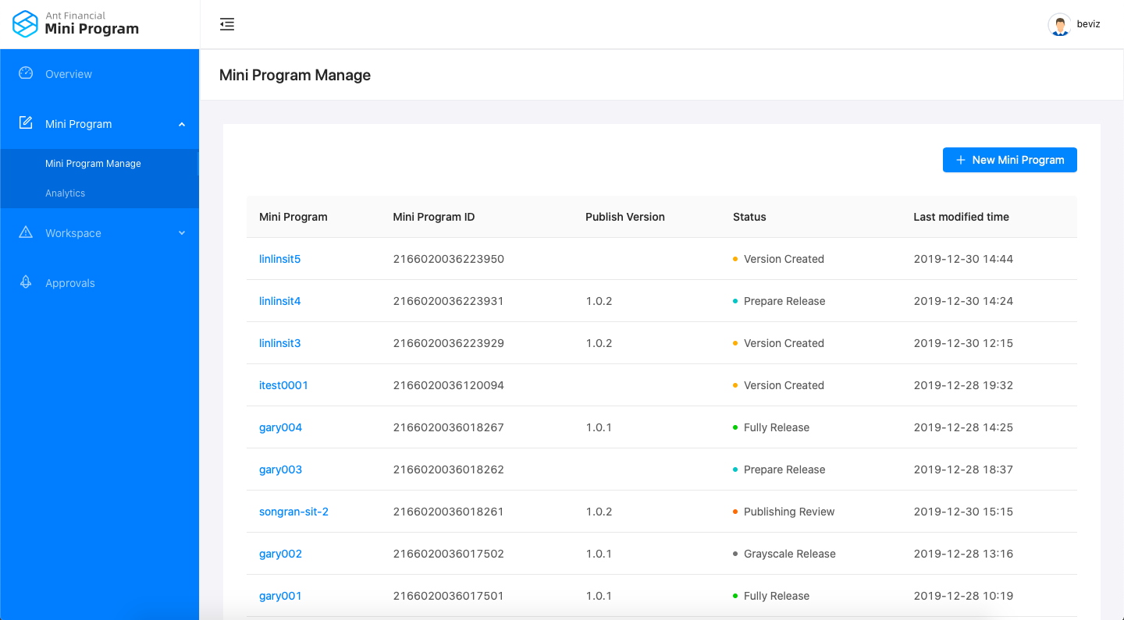
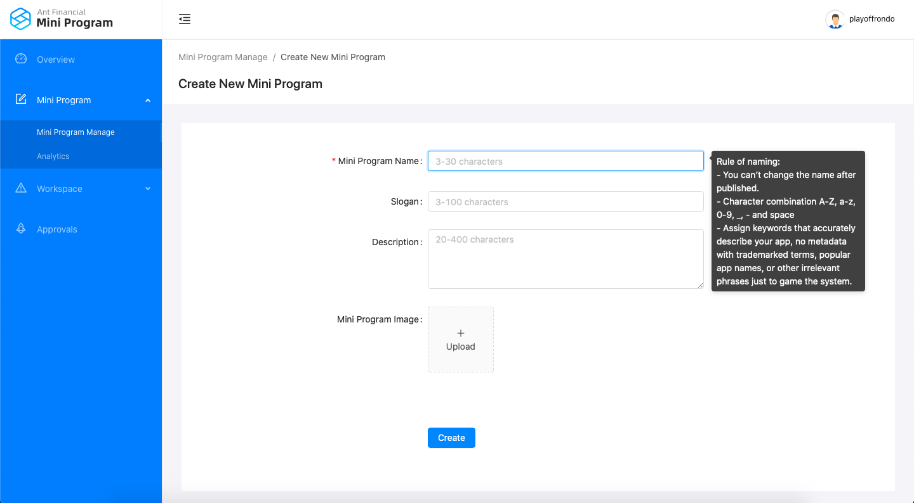
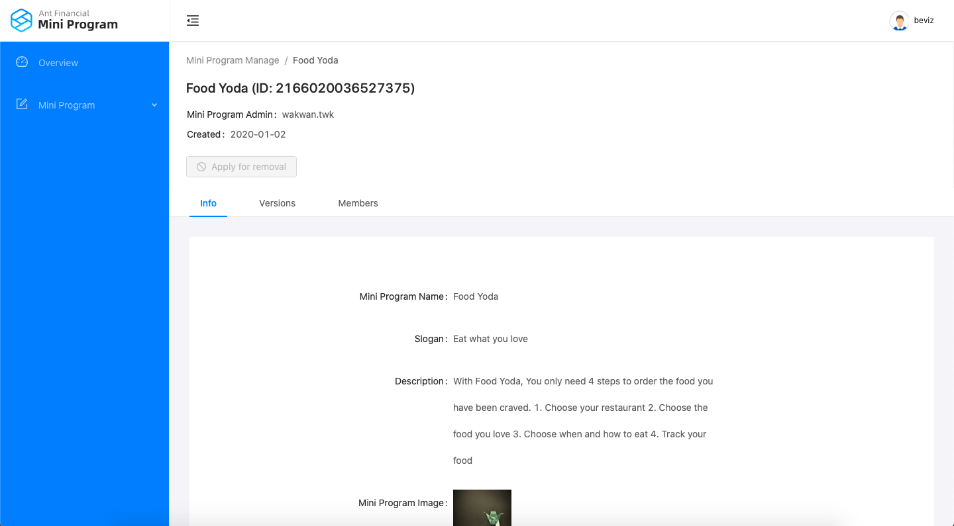
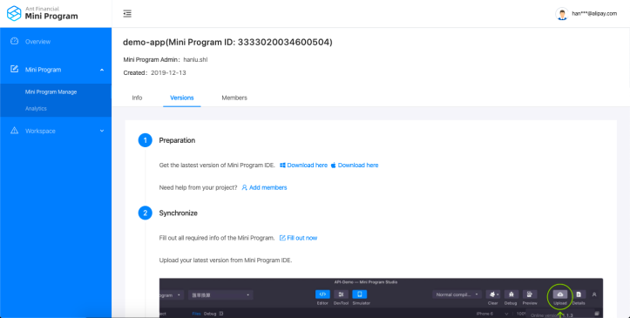
Publish a Mini Program (1/6)
You need a Mini Program Admin role to create a new mini program
Step 1 Create a new mini program by clicking the blue “+ New Mini Program” button Step 2 Fill out the required info following the instructions
Step 3 The Mini Program ID will be generated automatically
Step 4 Download the Mini Program Studio (IDE) by following the instructions on the Mini Program Manage – The Mini Program you just created - Version tab

Slide 3
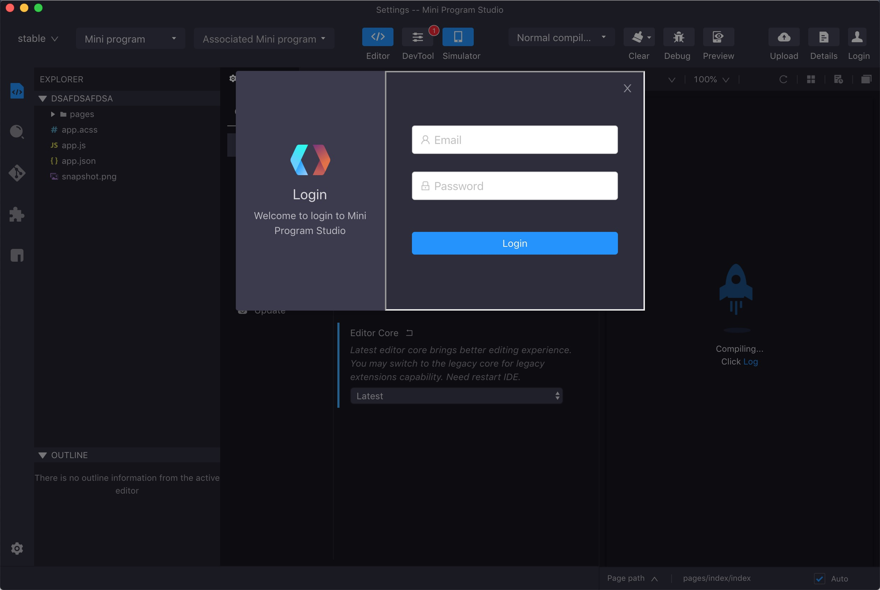
Publish a Mini Program (2/6)
Step 5 Using the same AIMPDP credentials, login to the Mini Program Studio
Main Features
Quick start code templates
Syntax Highlighting
Auto code completion
On-the-fly compilation
Built-in source control support
Debug console
Debug with Simulator or Remote device
Simulator
Mini Program Upload
Preview in phone
Extensible plugins
Available in both MacOS and Windows

Slide 4
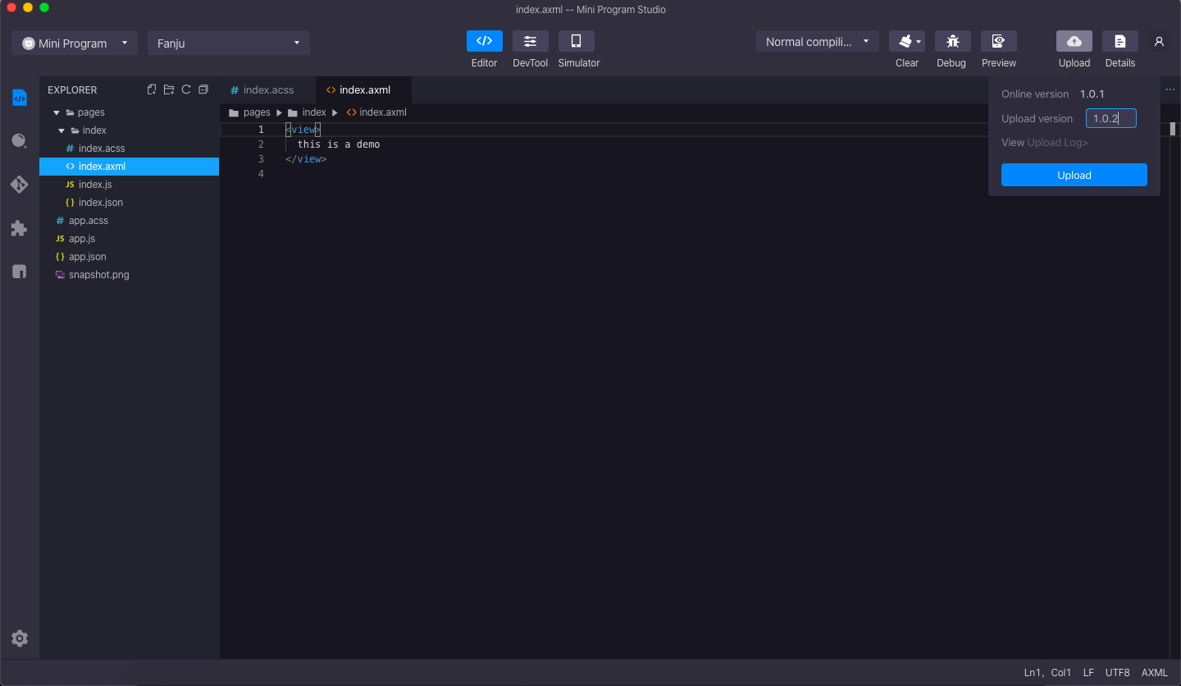
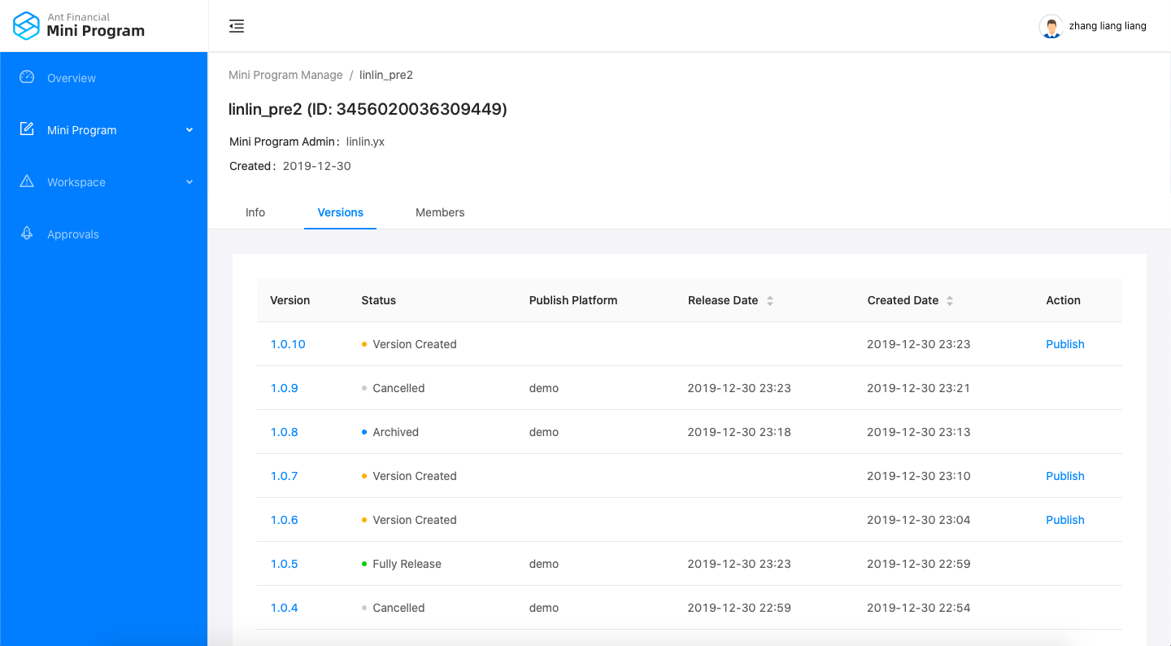
Publish a Mini Program (3/6)
Step 6 Upload the source code of the current project to the Development Console filling out the correct version
After the upload process is completed, the newest version will be displayed in the console and the status will be shown as “Version Created”

Slide 5
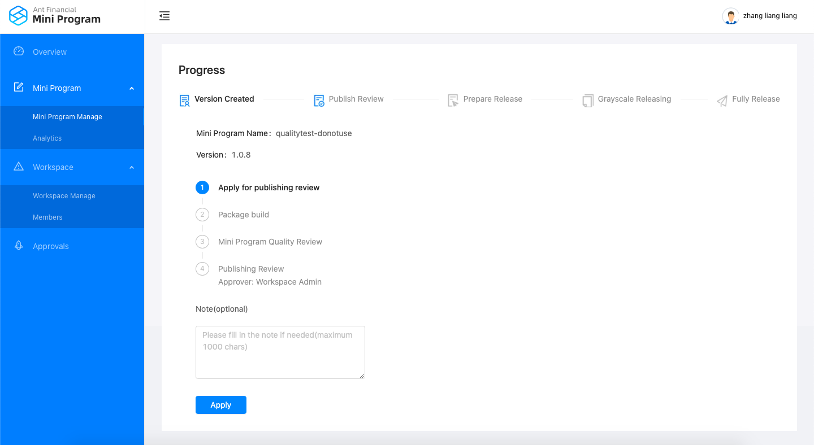
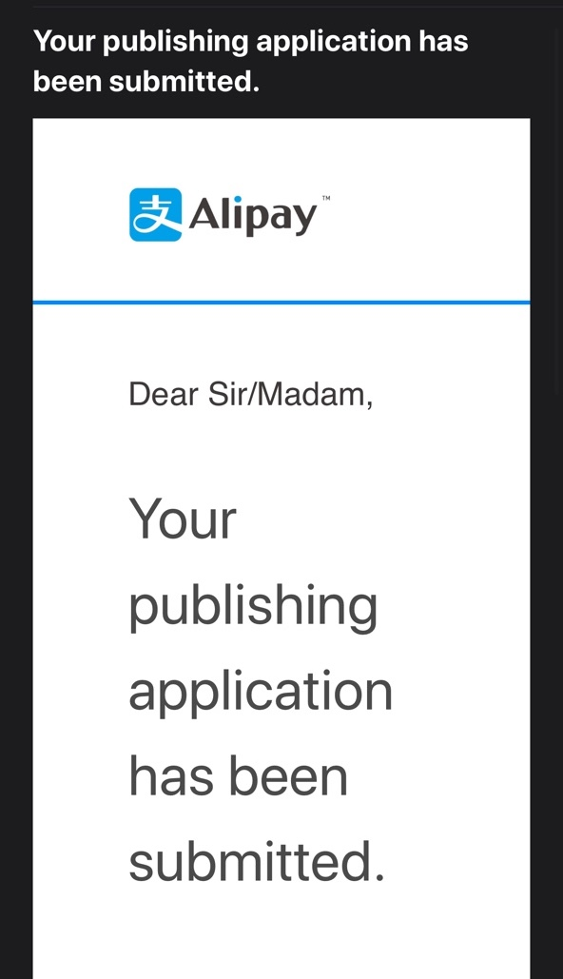
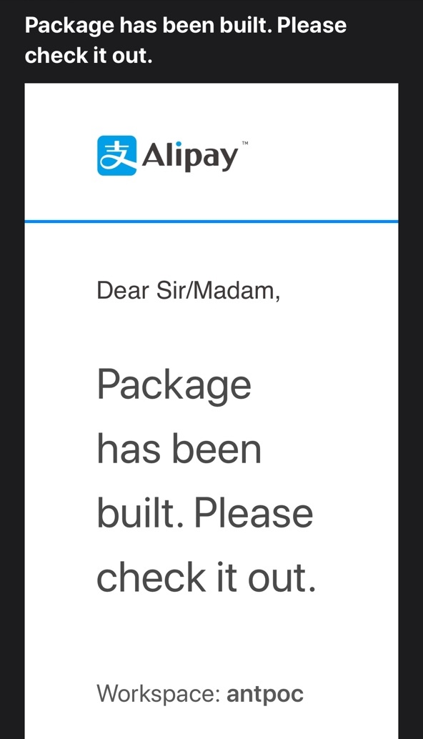
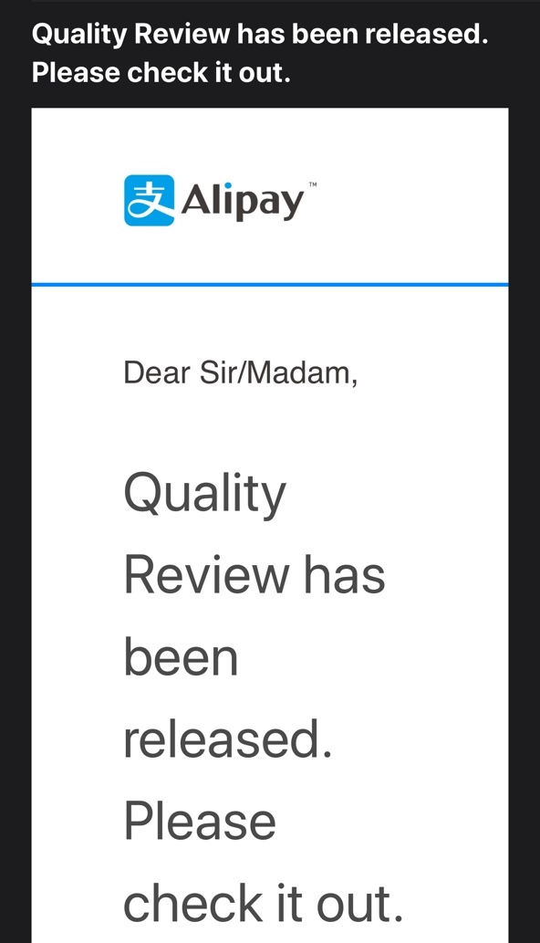
Publish a Mini Program (4/6)
Step 7 Apply for publishing review on Publish tab
The Package will take a few seconds to be built
The Mini Program Quality Review will take approximately 15 minutes to be released
You will receive notification emails for updates of publishing
The Workspace Admin will receive an email regarding publishing application status updates, and decide whether or not to approve your publishing application depending on the mini program demo and Quality Review

Slide 6
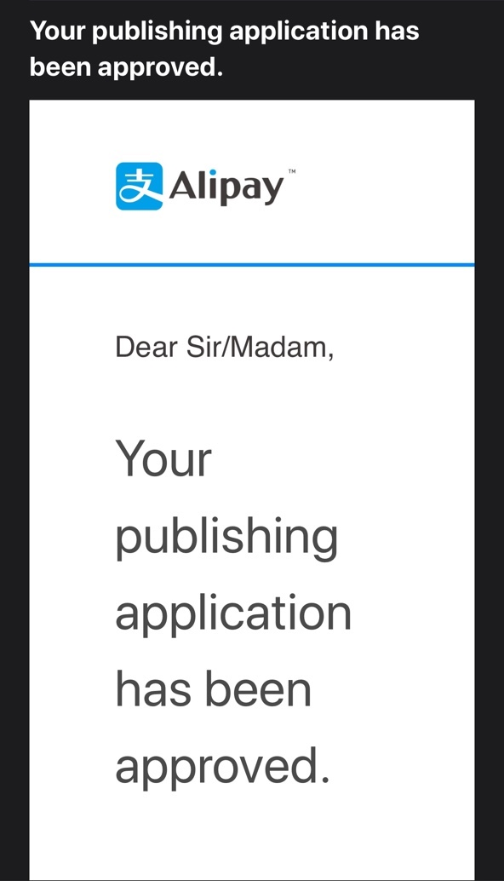
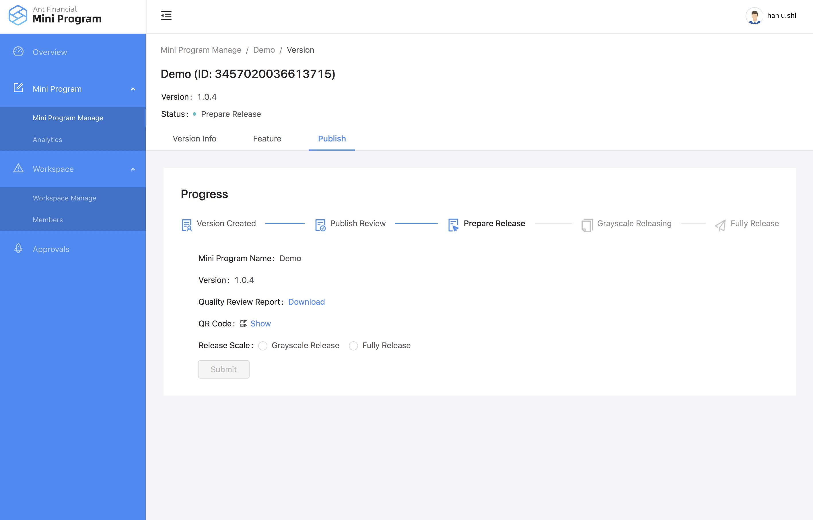
Publish a Mini Program (5/6)
Step 8 Release your Mini Program by choosing either grayscale release or fully release
Grayscale release:
The Grayscale releases are tested by introducing a new version to a small portion of user traffic. You can increase (gradually if needed) the percentage and gradually replace the older version. If any problems occur during the process, you can abort and roll back to an old version. The easiest way to do this is to select a percentage request to a Grayscale version. There are more factors for grayscale like content of the requests, a specific range of users, other properties, etc.
Currently we only support grayscale release by percentage.

Slide 7
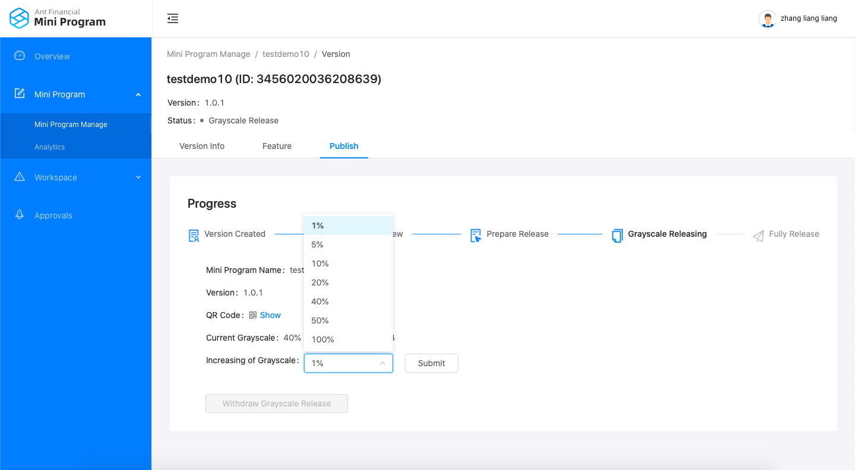
Publish a Mini Program (6/6)
Step 9 Increase your grayscale by selecting higher percentage or fully release (100%)
A Mini Program Admin can be able to withdraw the grayscale release after the status is set to grayscale releasing

